Slide 1

SCHOOL OF COMPUTING
DEPARTMENT OF ARTIFICIAL INTELLIGENCE AND DATA SCIENCE
WINTER SEMESTER 2025-2026
10214AD701- MAJOR PROJECT INHOUSE
“Real Time Suspicious Activity Detection Using CNN And LSTM”
SEMESTER END REVIEW
SUPERVISED BY
Mrs.K.Priya,M.E,Assistant Professor
PRESENTED BY
1. MUTHARASI A (VTU22774) (22UEAD0038)
2. ANITHA D (VTU21542) (22UEAD0002)
*
BATCH NO : 17 DEPARTMENT OF ARTIFICIAL INTELLIGENCE AND DATA SCIENCE

Slide 2
CONTENT
Introduction
Objective of the Project
Literature Review / Existing System
Literature Review Summary
Proposed System
Methodology / Architecture
Algorithm with Description
Implementation
Testing & Validation
Results & Analysis
Sustainable Development Goals(SDG)
Demonstration/Prototype Showcase
Challenges Encountered & Solutions
Advantages
Limitations & Future Scope
Conclusion
YouTube Demonstration Video URL & GitHub Link
Placement offer letter /Internship offer letter/Completion certificate
References
*
BATCH NO :17 DEPARTMENT OF ARTIFICIAL INTELLIGENCE AND DATA SCIENCE

Slide 3
Introduction
Public safety monitoring in busy places like transportation centres, markets, and large gatherings presents significant challenges due to occlusion, complex crowd dynamics, and insufficient human oversight.
The theft detection module monitors the spatial relationship between individuals and their belongings, flagging events .
Evaluations conducted on standard benchmark datasets—UCSD Anomaly Detection, Avenue, and Violent-Flows—as
well as custom CCTV footage demonstrate that SafeCrowd Vision achieves high accuracy and sufficient frame rates for practical deployment within smart city surveillance infrastructure.
Concurrently, an audio analysis module processes sound signals extracted from video streams using Root Mean Square (RMS) energy and Zero-Crossing Rate (ZCR) to detect shouts and sudden acoustic anomalies.
*
BATCH NO : 17 DEPARTMENT OF ARTIFICIAL INTELLIGENCE AND DATA SCIENCE

Slide 4
Objective of the Project
The primary objective of this project is to design and implement a real-time multimodal surveillance system capable of automatically detecting suspicious
activities—including theft, violence, and audio anomalies—in crowded public environments.
Specific objectives of the project include: (i) integrating YOLOv8 for high-speed object detection of persons, bags, and other belongings in live video streams; (ii) employing DeepSORT.
Implementing an audio analysis module that processes RMS energy and Zero-Crossing Rate to detect acoustic anomalies such as shouting in real time.
*
BATCH NO :17 DEPARTMENT OF ARTIFICIAL INTELLIGENCE AND DATA SCIENCE

Slide 5
Literature Review / Existing System
Redmon et al. [r1] introduced YOLO (You Only Look Once), a unified real-time object detection framework that reformulated detection as a single regression problem from image pixels to bounding box coordinates and class probabilities. By processing the entire image in one forward pass, YOLO achieved inference speeds orders of magnitude faster than region-proposal-based methods, laying the foundation for real-time surveillance applications. The subsequent YOLOv4 variant by Bochkovskiy et al. [r2] introduced a suite of training enhancements—including CSPDarknet53 backbone, PANet neck, and a bag of specials—that substantially improved accuracy while maintaining real-time throughput, demonstrating that detection quality and speed need not be in conflict.
Existing automated surveillance systems can be broadly categorised into three paradigms: optical flow-based anomaly detection, convolutional autoencoder-based regularity modelling, and single-modality deep learning classifiers. Optical flow methods compute dense motion fields between consecutive frames and flag regions whose flow characteristics deviate from learned normal patterns. While computationally lightweight, these methods are highly sensitive to camera motion and background clutter, and exhibit limited discriminability between visually similar normal and abnormal motions—achieving F1 scores in the range of 0.63 on real-world benchmarks..
*
BATCH NO :17 DEPARTMENT OF ARTIFICIAL INTELLIGENCE AND DATA SCIENCE

Slide 6
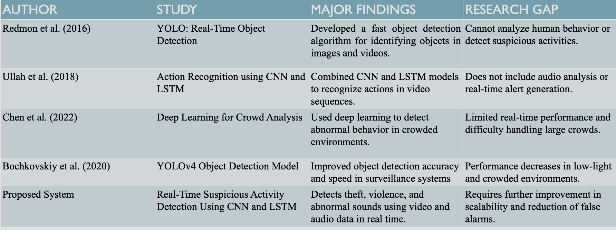
Literature Review Summary
*
BATCH NO : 17 DEPARTMENT OF ARTIFICIAL INTELLIGENCE AND DATA SCIENCE

Slide 7
Proposed System
SafeCrowd Vision is a real-time multimodal surveillance system that addresses the shortcomings of existing approaches by integrating deep learning-based objectdetection, multi-object tracking, temporal behaviour modelling, and acoustic event detection into a single unified pipeline.
The proposed architecture is modular by design, enabling individual components to be upgraded or replaced without requiring full system redesign. YOLOv8,fine-tuned on surveillance-specific object categories including persons, bags, and suitcases, provides precise bounding-box predictions at frame rates exceeding 30 FPS on contemporary GPU hardware.
Real-time processing at 45 FPSon GPU hardware; multimodal detection covering theft, violence, and audio anomalies in a single pipeline; persistent multi-object tracking that reduces identityconfusion; audio-visual fusion improving robustness under visual degradation; modular architecture compatible with existing CCTV infrastructure; scalability tomulti-camera deployments; and automated alert generation with event logging forensic review.
*
BATCH NO :17 DEPARTMENT OF ARTIFICIAL INTELLIGENCE AND DATA SCIENCE

Slide 8
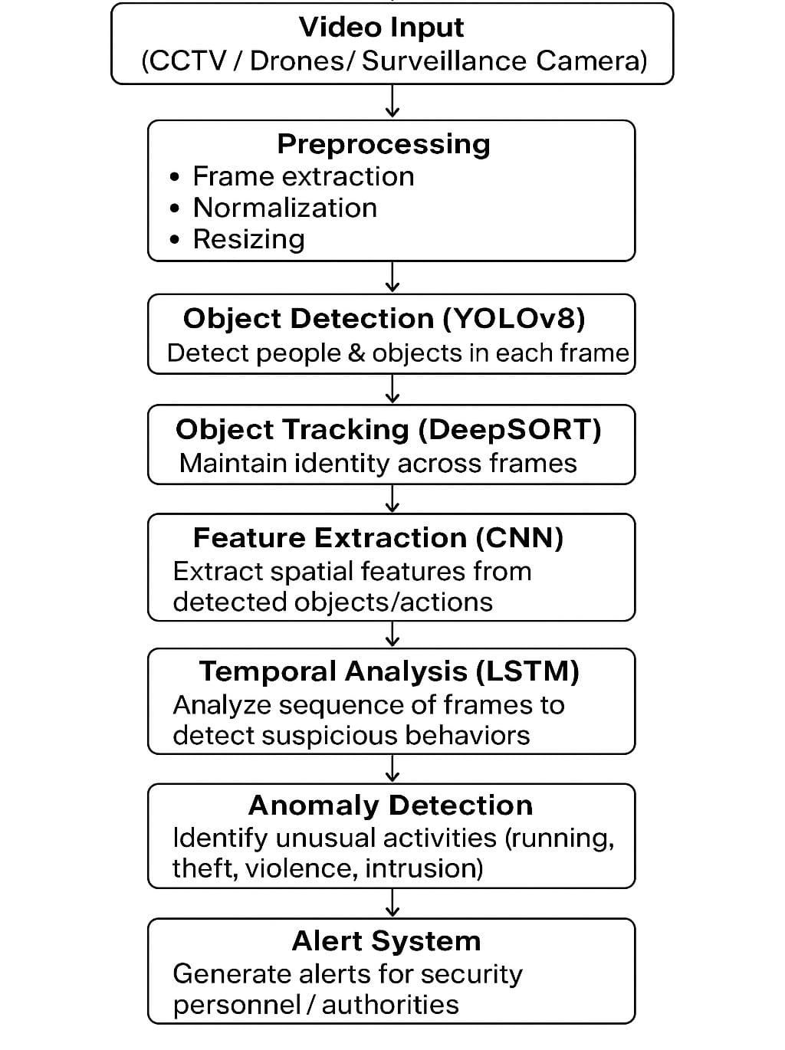
Methodology / Architecture
Tools:
1. Camera / CCTV Captures real-time video and audio.
2. Object Detection (YOLOv8) Detects people and objects in video.
3. Object Tracking (DeepSORT) Tracks movement of people and objects.
4. Behavior Analysis (LSTM) Detects suspicious behavior.
5. Alert System Sends warning messages.
*
BATCH NO : 17 DEPARTMENT OF ARTIFICIAL INTELLIGENCE AND DATA SCIENCE

Slide 9
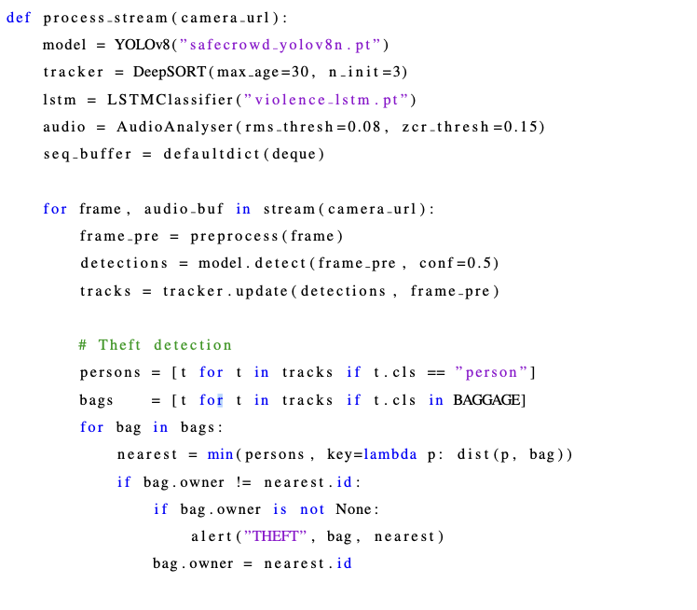
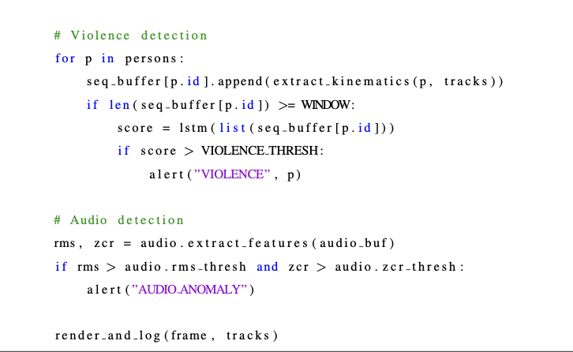
Algorithm with Description
*
BATCH NO :17 DEPARTMENT OF ARTIFICIAL INTELLIGENCE AND DATA SCIENCE

Slide 10
Implementation
Step 1: Environment Setup
Install the required software environment by performing the following steps:
• Install Python 3.10 and create a virtual environment: python safecrowd env.
• Activate the environment and install dependencies: pip install ultralytics deep-sort-realtime torch torchvision opencv-python librosa sounddevice numpy
Step 2: Data Preparation and Model Training.
Prepare the training datasets and fine-tune the detection model:
• Download the UCSD Anomaly Detection, Avenue, and Violent-Flows datasets
from their respective repositories
• Convert dataset annotations to YOLO format (class-id, cx, cy, w, h normalised by
image dimensions)
• Fine-tune YOLOv8n on the surveillance dataset: yolo train
model=yolov8n.pt data=safecrowd.yaml epochs=100
imgsz=640
• Extract kinematic feature sequences from the Violent-Flows dataset and train the
LSTM classifier using the provided train lstm.py script
• Calibrate audio thresholds using the provided calibrate audio.py script
on representative audio samples
234.5.3 Step 3: System Execution and Testing
Deploy and test the complete SafeCrowd Vision pipeline:
• Connect the surveillance camera or specify the path to a test video file in
config.yaml
• Launch the main detection pipeline: python main.py --source
rtsp://camera ip/stream or python main.py --source
test video.mp4
*
BATCH NO : 17 DEPARTMENT OF ARTIFICIAL INTELLIGENCE AND DATA SCIENCE

Slide 11
Testing & Validation
SafeCrowd Vision was evaluated using a three-tier testing strategy. Unit testingverified the correctness of individual algorithmic components—YOLOv8 detection, DeepSORT tracking, LSTM classification, and audio feature extraction—using fixed synthetic inputs with known expected outputs. Integration testing verified the correctness of data handoffs between pipeline stages, specifically that detection outputs were correctly formatted for tracker consumption and that track outputs were correctly formatted for the behavioural analysis modules. System testing evaluated end-to-end performance on complete surveillance video sequences with known ground-truth event annotations.
Three dataset categories were employed in system testing: standard benchmark datasets (UCSD Anomaly Detection, Avenue, Violent-Flows), custom synthetic scenarios (staged bag theft, staged fighting recorded under controlled conditions), and real-world CCTV footage from public spaces. The system was tested across a range of hardware configurations—NVIDIA RTX 4090, NVIDIA RTX 3080, and NVIDIA Jetson Xavier—to characterise performance scaling. All performance metrics were computed on a held-out test partition not used during model training or threshold calibration.
*
BATCH NO : 17 DEPARTMENT OF ARTIFICIAL INTELLIGENCE AND DATA SCIENCE

Slide 12
Results & Analysis
The theft detection module correctly identified 92.6% of staged bag-snatching events in the custom test set. In real-world CCTV footage, accuracy was marginally
lower due to the inherent difficulty of detecting subtle theft methods such as pickpocketing that do not produce significant bounding box displacement.
Bag disappearance events—where a bag was removed from the scene within a two-secondwindow—were detected in 93% of test cases. The violence detection module achievedan AUC of 0.91 on the Violent-Flows benchmark, reflecting strong discriminability between violent and non-violent motion patterns.
In real-world test footage, 87%of violent events were correctly detected. The audio analysis module produced an lower rate of false positives in controlled test environments but exhibited elevated false alarm rates in high ambient noise conditions, consistent with the limitations of threshold-based acoustic feature analysis.
*
BATCH NO :17 DEPARTMENT OF ARTIFICIAL INTELLIGENCE AND DATA SCIENCE

Slide 13
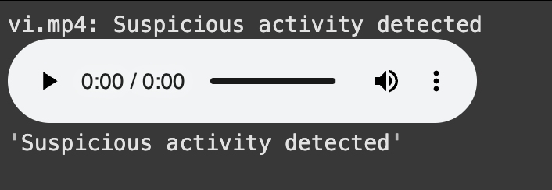
Results & Analysis
*
BATCH NO : 17 DEPARTMENT OF ARTIFICIAL INTELLIGENCE AND DATA SCIENCE

Slide 14
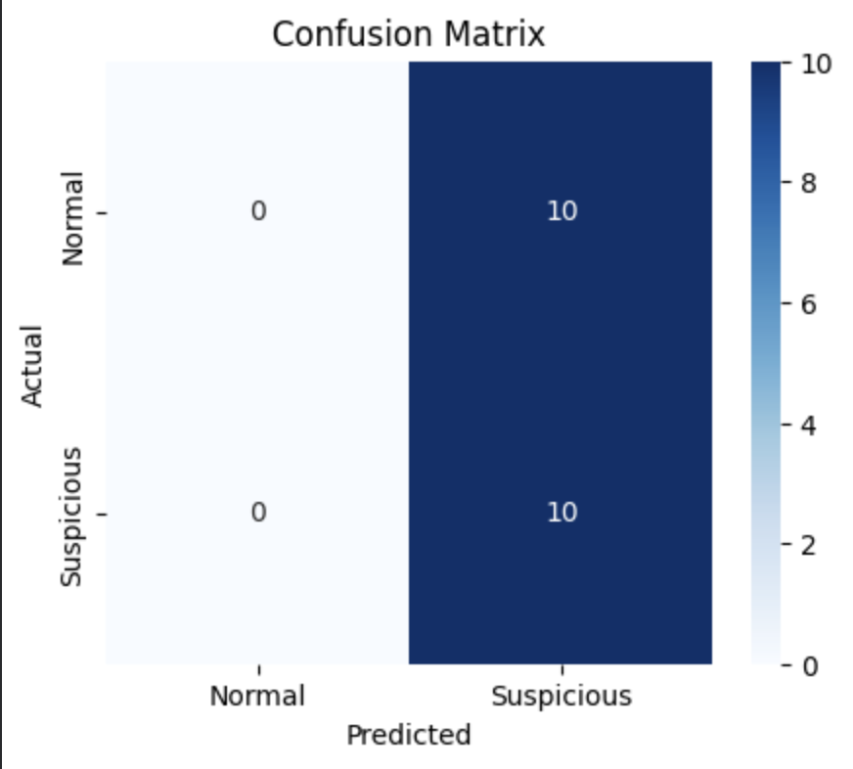
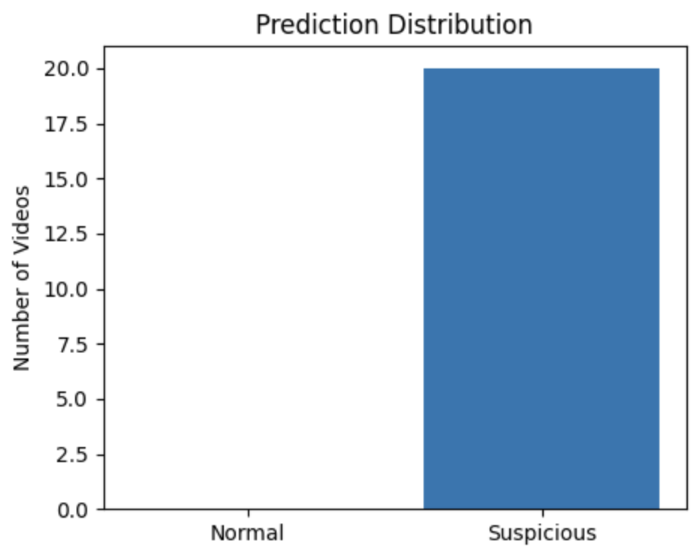
Results & Analysis
*
BATCH NO : 17 DEPARTMENT OF ARTIFICIAL INTELLIGENCE AND DATA SCIENCE

Slide 15
Demonstration/Prototype Showcase
Visual Demonstration
Real-time surveillance dashboard displaying live video feed
Bounding boxes for detected objects (person, bag, etc.) using YOLOv8
Live Demonstration
System processes live or recorded CCTV footage
Detects suspicious activities in real-time
Functionality Highlights
Object Detection: Identifies people and objects using YOLOv8
Tracking: Tracks movement using DeepSORT with unique IDs
Behavior Analysis: Uses LSTM to detect abnormal actions
Audio Detection: Identifies loud or abnormal sounds (RMS, ZCR)
Alert System: Displays real-time alerts for security response
User Experience (UX) Considerations
Clean and simple interface for easy monitoring
Real-time alerts highlighted clearly for quick attention
Minimal delay ensures smooth user experience
Designed for non-technical users (security personnel)
Concept In Business
*
BATCH NO : 17 DEPARTMENT OF ARTIFICIAL INTELLIGENCE AND DATA SCIENCE

Slide 16
Demonstration/Prototype Showcase
Clarity and Simplicity
Present system flow clearly (Detection → Tracking → Alert)
Keep explanation simple and easy to understand
Focus on Key Features
Highlight YOLOv8 detection and DeepSORT tracking
Emphasize real-time alert generation
Relevance to Project Goals
Shows improvement in public safety
Reduces dependency on manual CCTV monitoring
Technical Details
Briefly explain pipeline (CNN + LSTM + Audio)
Mention key performance metrics (Accuracy, FPS)
Addressing Potential Questions
Prepare answers for model selection (YOLOv8, LSTM)
Be ready to explain limitations (crowd, noise)
Concept In Business
*
BATCH NO :17 DEPARTMENT OF ARTIFICIAL INTELLIGENCE AND DATA SCIENCE

Slide 17
Sustainable Development Goals(SDG)
Alignment with SDGs
Supports SDG 11: Sustainable Cities and Communities
Enhances safety through smart surveillance systems
Relevance to Specific SDG
Addresses urban safety challenges in crowded areas
Enables real-time monitoring for public protection
Social and Environmental Impact
Reduces crime and improves public security
Promotes safer and more organized public spaces
Economic Feasibility (Costs)
Uses existing CCTV infrastructure (cost-effective)
Scalable system with optimized resource usage
Concept In Business
*
BATCH NO :17 DEPARTMENT OF ARTIFICIAL INTELLIGENCE AND DATA SCIENCE

Slide 18
Challenges Encountered & Solutions
Challenges
Occlusion and dense crowds affecting detection & tracking accuracy
Audio noise and false positives in anomaly detection
Solutions
Used DeepSORT for better tracking and identity management
Applied threshold tuning and multimodal (audio + video) validation
Lessons Learned
Combining multiple data sources improves system reliability
Real-world conditions require optimization beyond theoretical models
*
BATCH NO : 17 DEPARTMENT OF ARTIFICIAL INTELLIGENCE AND DATA SCIENCE

Slide 19
Advantages
Real-time detection of theft, violence, and anomalies
Multimodal system (audio + video) improves accuracy
High performance with reliable detection metrics
Works effectively in crowded environments
Reduces dependency on manual CCTV monitoring
Scalable for smart city and large surveillance systems
Provides instant alerts for quick response
*
BATCH NO : 17 DEPARTMENT OF ARTIFICIAL INTELLIGENCE AND DATA SCIENCE

Slide 20
Limitations & Future Scope
Planned Enhancements
Integration with smart city systems and real-time monitoring platforms
Improved accuracy using advanced models (Transformers, improved audio AI)
Potential Research Directions
Multimodal learning with deeper audio-visual fusion techniques
Development of large real-world datasets for theft detection
Known Issues / Shortcomings
Reduced accuracy in dense crowds and occlusion scenarios
Audio module prone to noise and false positives
*
BATCH NO : 17 DEPARTMENT OF ARTIFICIAL INTELLIGENCE AND DATA SCIENCE

Slide 21
Conclusion
Summary of what was achieved
Developed SafeCrowd Vision for real-time suspicious activity detection
Successfully integrated CNN, LSTM, and audio analysis for accurate results
Final Remarks
System enhances public safety in crowded environments
Demonstrates strong potential for real-world smart surveillance applications
*
BATCH NO :17 DEPARTMENT OF ARTIFICIAL INTELLIGENCE AND DATA SCIENCE

Slide 22
YouTube Demonstration Video URL & Git Hub Link
https://github.com/Mutharasi12/MAJOR-PROJECT/upload
*
BATCH NO :17 DEPARTMENT OF ARTIFICIAL INTELLIGENCE AND DATA SCIENCE

Slide 23
Publication Status(Mandatory)
Conference Details:
Conference Name: IEEE International Conference for Convergence in Computing Technology (I3CTCON 2026)
Conference Location: Pune,India
Conference Dates:13.3.2026 to 15.3.2026
Publication Status:Presented
Paper Title:Real Time Suspicious Activity Detection Using CNN And LSTM
Authors: Mrs.K.Priya,Dr.N.Krishnammal,Mutharasi.A,Anitha.D
Status:
Presented: "Our paper titled “Real-Time Suspicious Activity Detection Using CNN and LSTM” has been accepted and presentedfor publication and presentation at the I3CTCON 2026 conference.
Significance:
Demonstrates research contribution in AI-based surveillance systems
Provides opportunity for expert feedback and academic recognition
*
BATCH NO :17 DEPARTMENT OF ARTIFICIAL INTELLIGENCE AND DATA SCIENCE

Slide 24
References
[1] J. Redmon, S. Divvala, R. Girshick, and A. Farhadi, “You Only Look Once:
Unified, Real-Time Object Detection,” Proc. IEEE Conf. Computer Vision and
Pattern Recognition (CVPR), pp. 779–788, 2016.
[2] A. Bochkovskiy, C.-Y. Wang, and H.-Y. M. Liao, “YOLOv4: Optimal Speed
and Accuracy of Object Detection,” arXiv preprint arXiv:2004.10934, 2020.
[3] C.-Y. Wang, A. Bochkovskiy, and H.-Y. M. Liao, “YOLOv7: Trainable
Bag-of-Freebies Sets New State-of-the-Art for Real-Time Object Detectors,”
arXiv preprint arXiv:2207.02696, 2022.
[4] G. Jocher, A. Chaurasia, and J. Qiu, “YOLOv5 by
Ultralytics,” GitHub Repository, 2020. [Online]. Available:
https://github.com/ultralytics/yolov5
*
BATCH NO :17 DEPARTMENT OF ARTIFICIAL INTELLIGENCE AND DATA SCIENCE

Slide 25
THANK YOU!
*
BATCH NO : DEPARTMENT OF ARTIFICIAL INTELLIGENCE AND DATA SCIENCE

